Slide 1
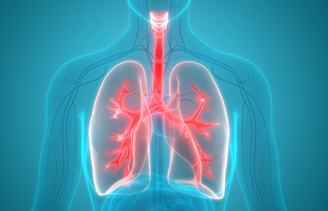
TEAM 10
₩
Predictive Model for the COPD Exacerbations
Korea Clinical Datathon 2019

Slide 2
TEAM 10
전북대학교 병원
Clinician : 김종승
Clinician : 김두환
Clinician : 여차동
Team Members
SQL Expert : 이세하 (고려대학교 의료원)
SQL Expert : 김정우 (DGIST)
Data Scientist : 국승호 (DIT)
IT Expert : 소재우 (테라젠이텍스)
Student : 왕예진 (University of Central Florida)
Student : 이보람 (방송통신대학교)
Student : 한기호 (상명대학교)
Korea Clinical Datathon 2019

Slide 3
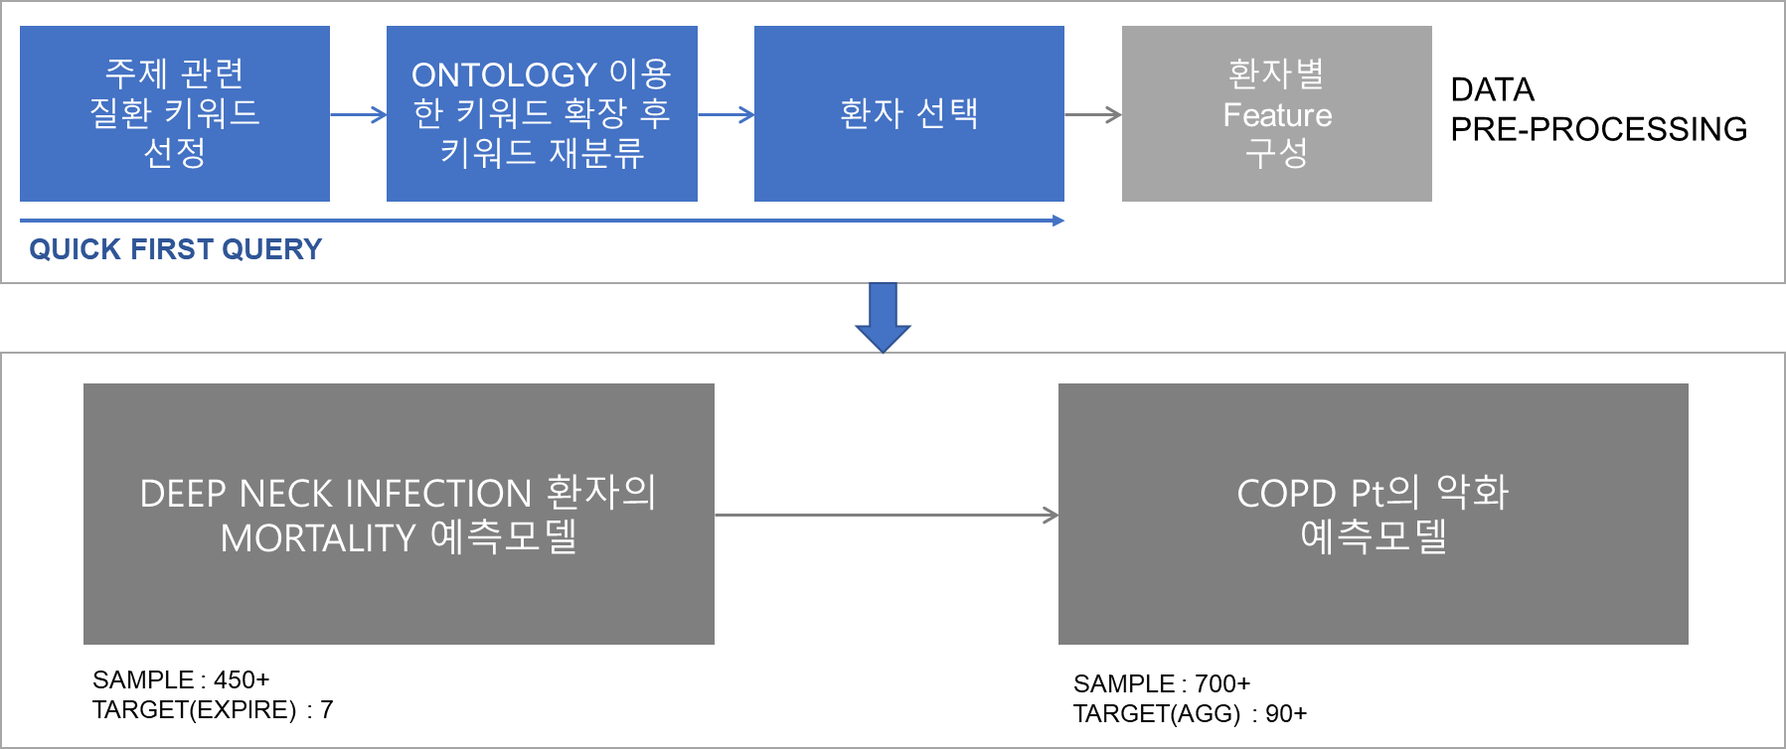
TOPIC 변경

Slide 4
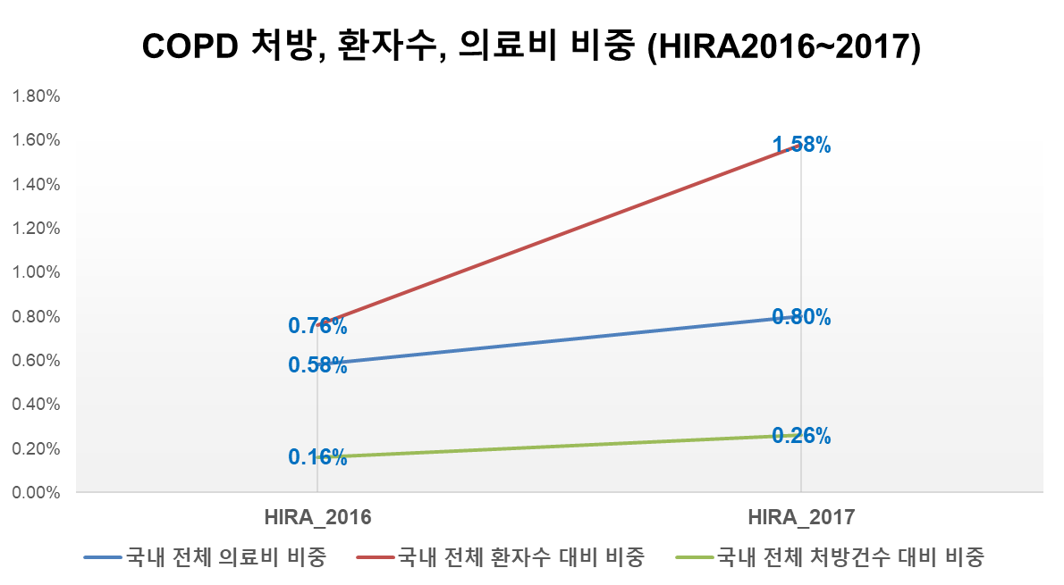
국내 전체 의료비 중 1% 육박..

Slide 5
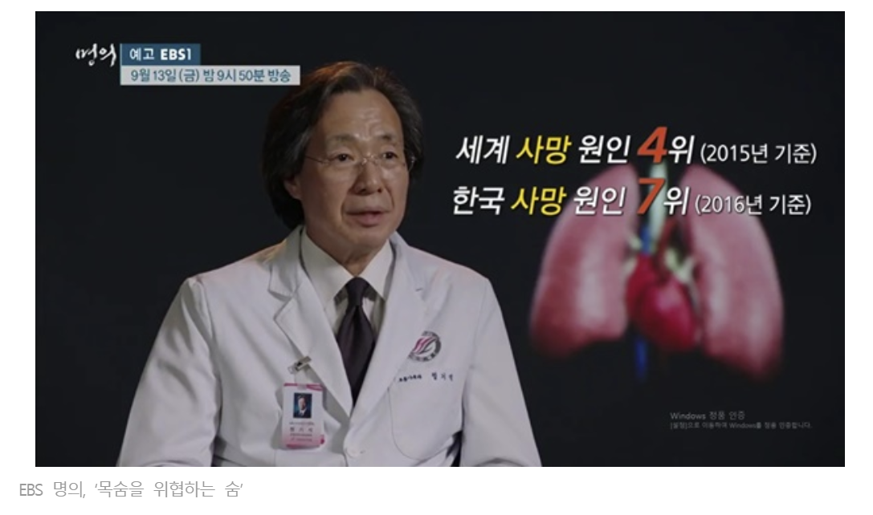
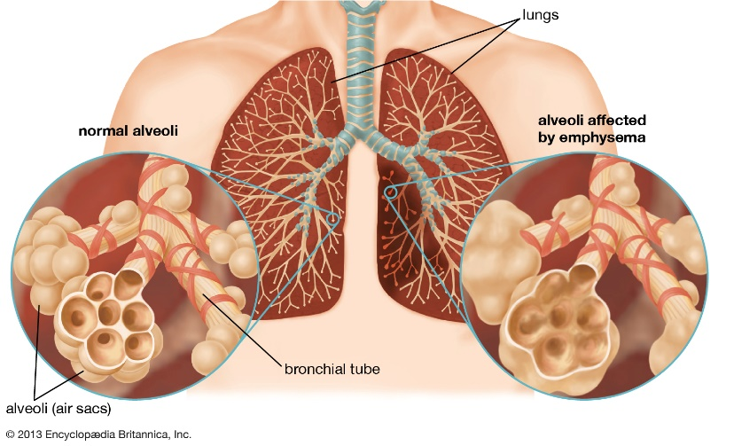
Chronic obstructive pulmonary disease (COPD)
prevalence of 251 million cases of COPD globally in 2016
3.17 million death (5% of all deaths globally in that year)

Slide 6
COPD
위험인자
SMOKING, AIR POLLUTION
COPD 급성 악화
acute worsening of respiratory symptoms that results in additional therapy
COPD 악화 인자
이전 악화 경험
감염
호산구 증가
다른 요인?

Slide 7
DISTRIBUTION
N = 673
TARGET

Slide 8
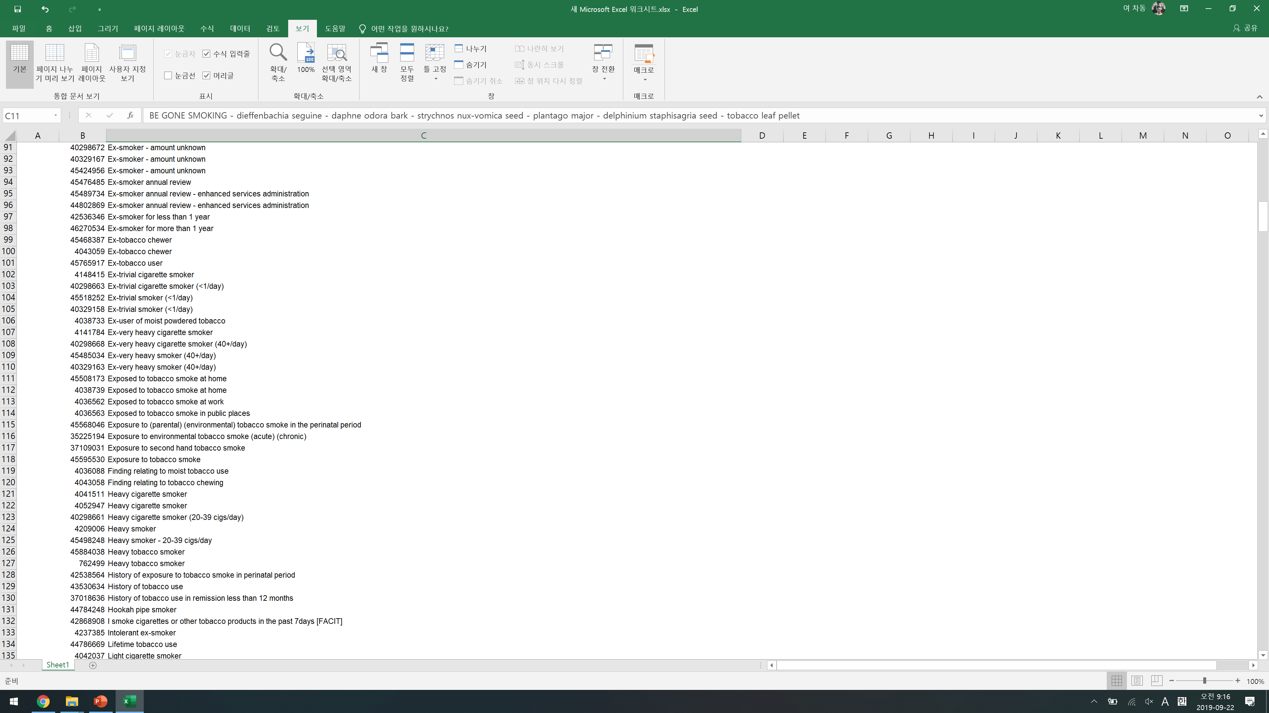
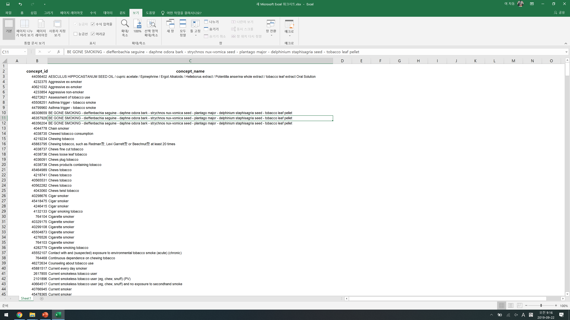
MAIN RISK FACTOR : SMOKING..
Only 8 smokers from
total CDM database

Slide 9
FEATURE SELECTION in aggravation of COPD
Demographic factor | Age | Lab | WBC
 | sex |  | Eosinophil
 | BMI |  | Cr
 | weight |  | ESR
 | height |  | CRP
COMORBIDITY | DM |  | lactate
 | CKD |  | Ig E
 | Acute sinusitis |  | HbA1c
 | Allergic rhinits | ABGA | pH
PFT | FEV1 |  | SpO2
 | FEV1/FVC |  | HCO3
 |  |  | pCO2

Slide 10
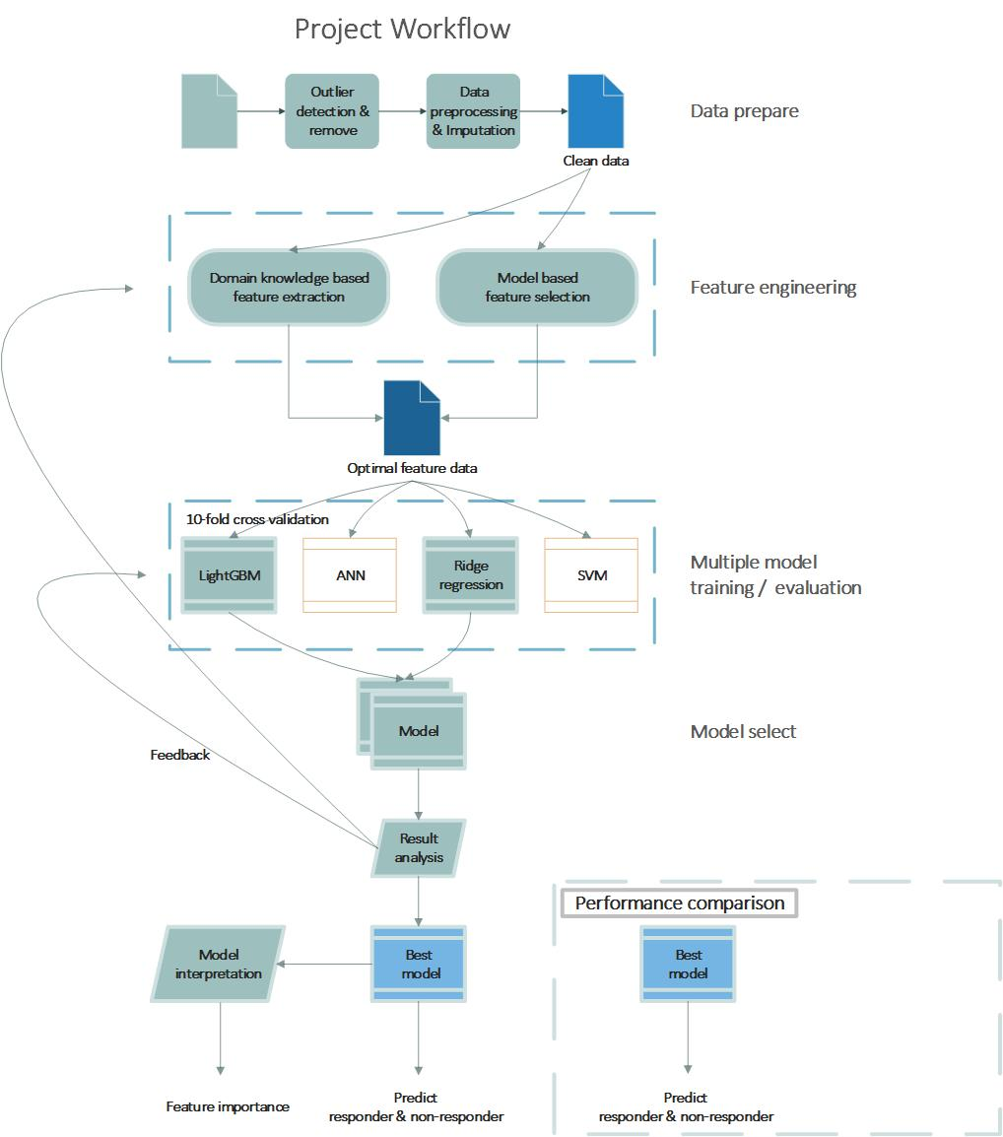
MODEL

Slide 11
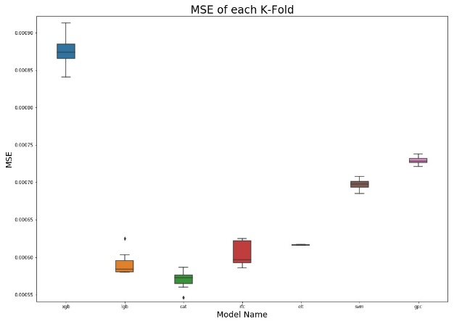
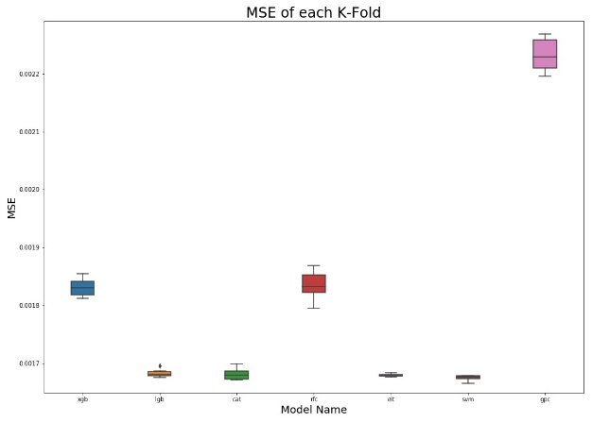
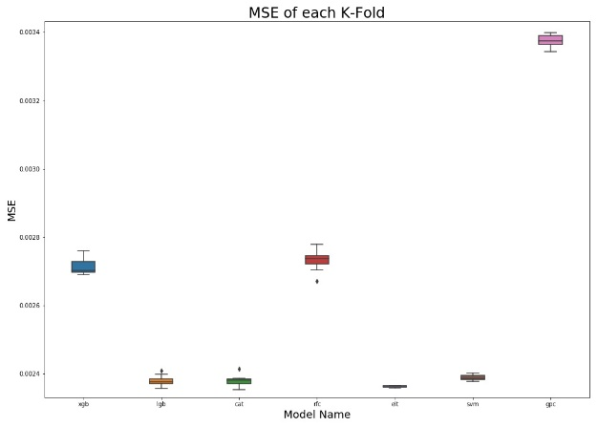
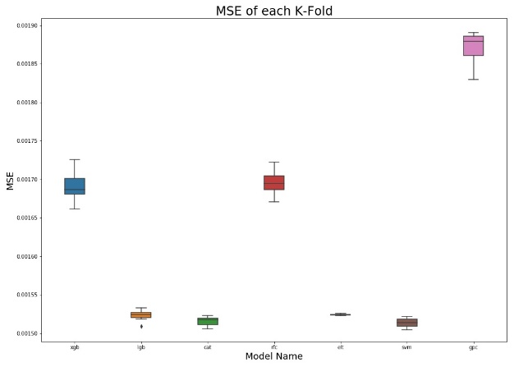
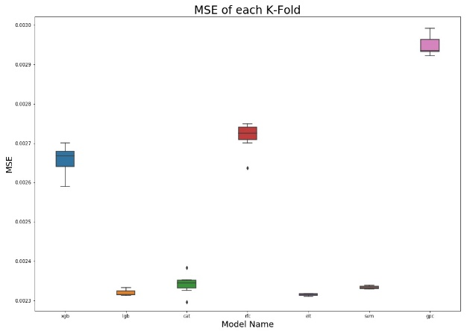
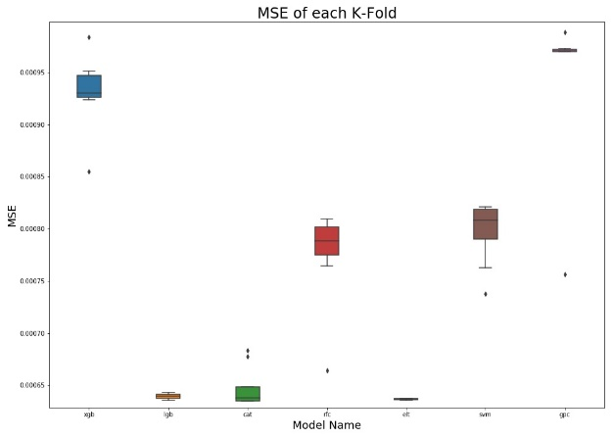
결측치 처리

Slide 12
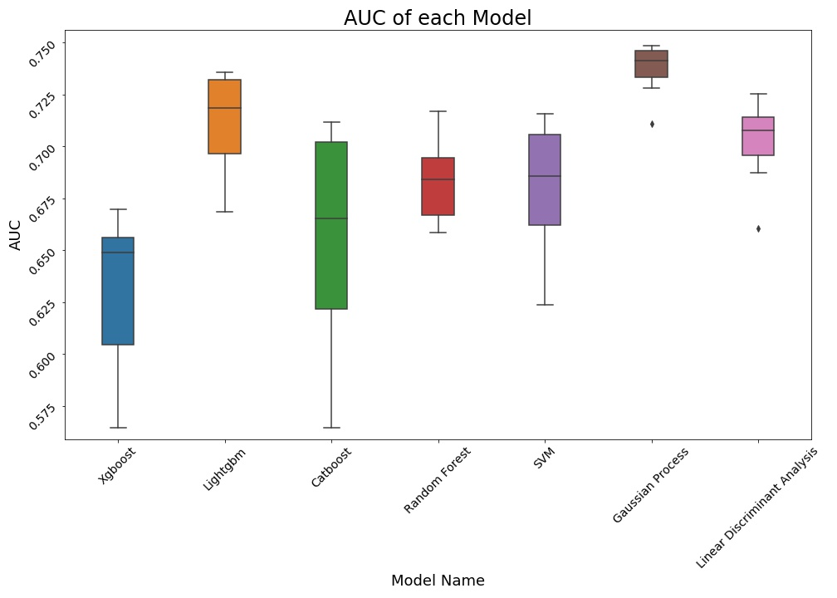
RESULT I

Slide 13
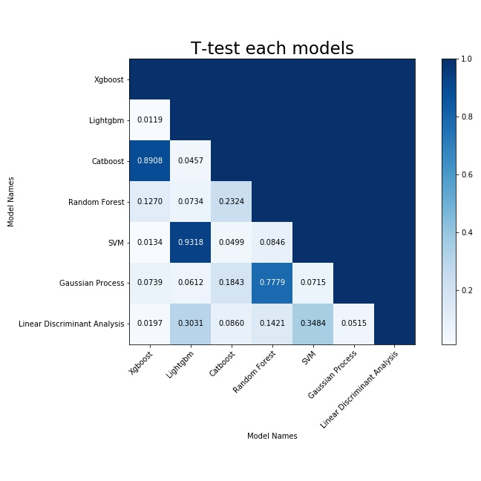
RESULT II

Slide 14
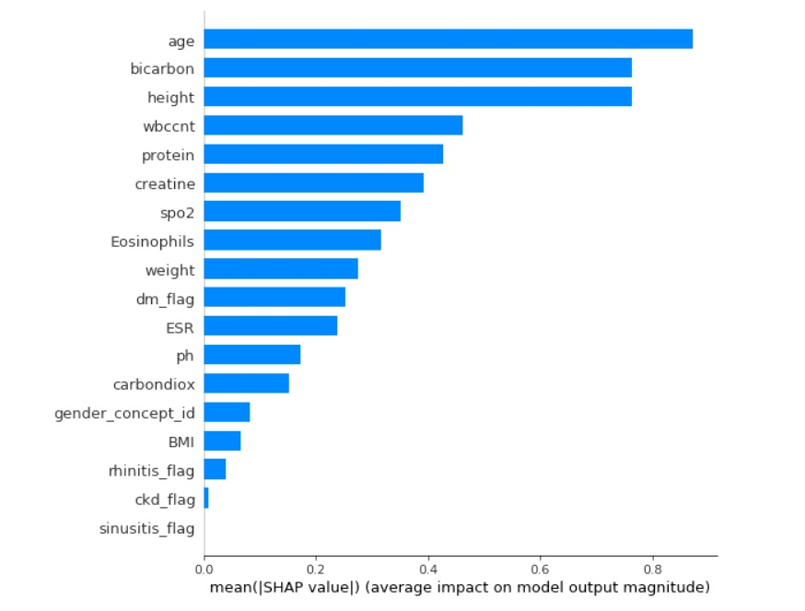
RESULT III

Slide 15
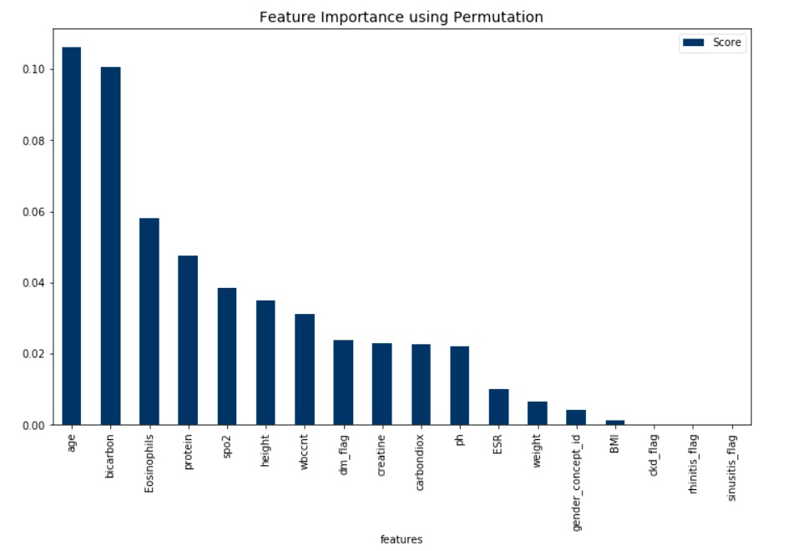
RESULT IV

Slide 16
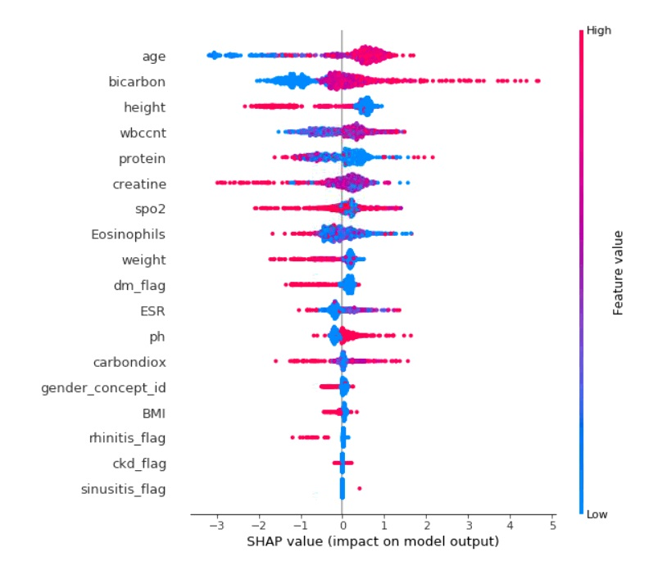
RESULT V

Slide 17
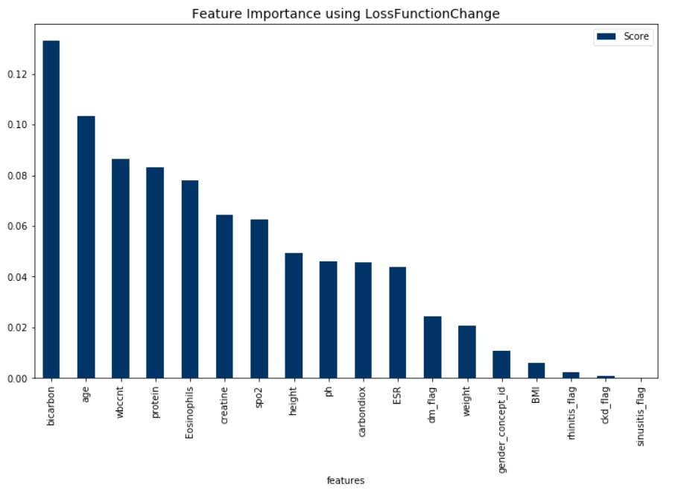
RESULT VI

Slide 18
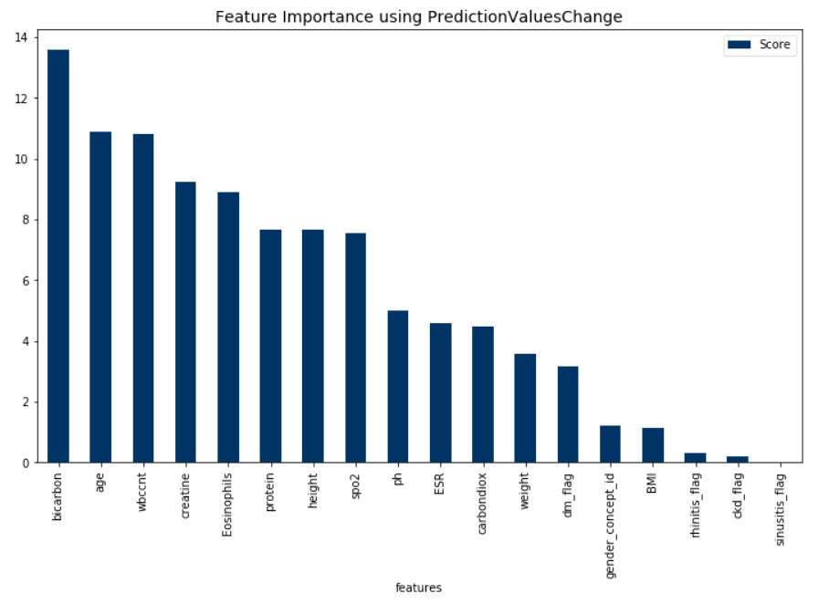
RESULT VII

Slide 19
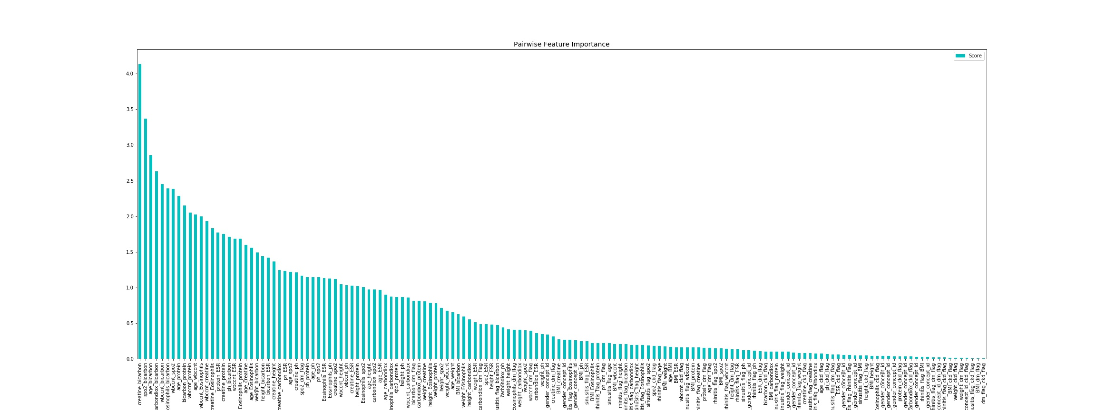
RESULT VIII

Slide 20
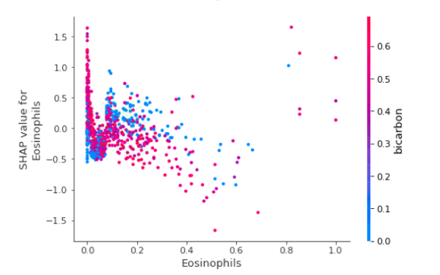
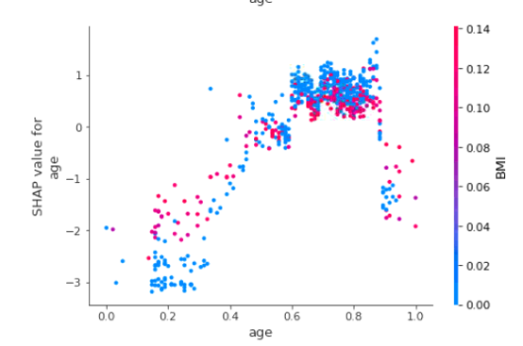
RESULT IX

